Slide 1
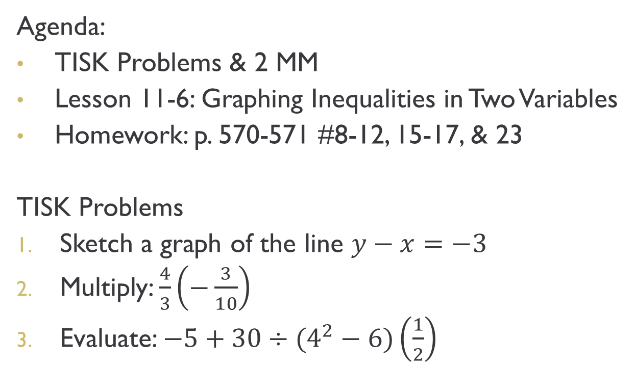
Friday, January 11, 2013
Agenda:
TISK Problems & 2 MM
Lesson 11-6: Graphing Inequalities in Two Variables
Homework: p. 570-571 #8-12, 15-17, & 23
TISK Problems
Sketch a graph of the line $y−x=−3$
Multiply: $\frac{4}{3}\left(−\frac{3}{10}\right)$
Evaluate: $−5+30÷(4^{2}−6)\left(\frac{1}{2}\right)$
Notes:
Mental Math
1.) Start with the number of inches in 1½ feet. Multiply by the number of feet in a yard. Divide by half a dozen. Double your result. (18)
2.) Start with the number of centimeters in 2 meters. Divide by the square root of 64. Multiply by the number of meters in a kilometer. Divide by the number of years in 2 millennia. Double it. Double it. Double it. (200)

Slide 2
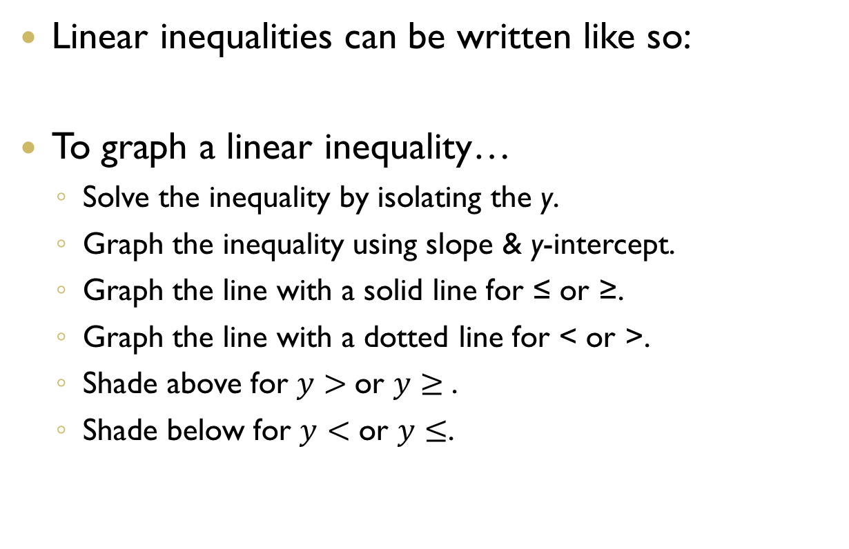
§11-6: Inequalities in Two Variables
Linear inequalities can be written like so:
To graph a linear inequality…
  Solve the inequality by isolating the y.
  Graph the inequality using slope & y-intercept.
  Graph the line with a solid line for ≤ or ≥.
  Graph the line with a dotted line for < or >.
  Shade above for $y>$or $y≥$.
  Shade below for $y<$ or $y≤$.

Slide 3
Example 1. Graph the inequality.
This is the graph of x < -2.
This is the line x = -2.

Slide 4
Example 2. Graph the inequality.

Slide 5
Example 3. Solve the inequality.

Slide 6
Check Point. Solve & graph the inequality.

Slide 7
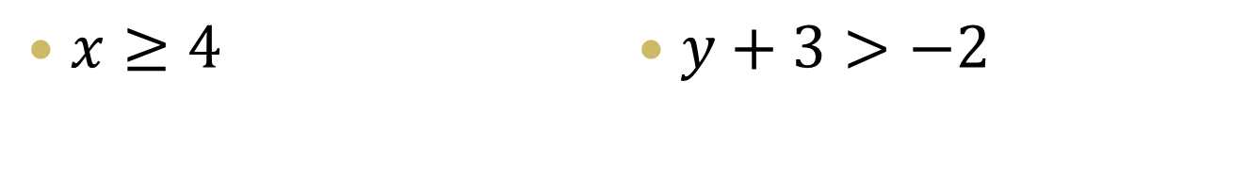
Check Points
Sketch a graph of the solution to each inequality.
$x≥4$
$y+3>−2$

Slide 8
Check Points
Sketch a graph of the solution to each inequality.
$x+y<−8$
$3x−y≥5$

Slide 9
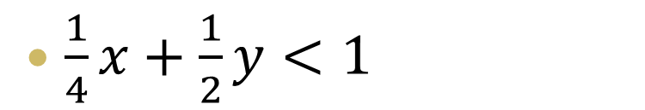
Check Points
Sketch a graph of the solution to each inequality.
$\frac{1}{4}x+\frac{1}{2}y<1$

